Slide 1


Team Details
  Team name: Tolerance
  Team leader name: Shreyash Sharma
  Problem Statement: Manufacturing. Plants run on scattered knowledge: manuals, orders, machine logs. When a station fails, nobody can quickly tell why, or whether a fix is safe. We built an agentic platform that learns a plant from its own documents and data, finds the cause, and acts only inside limits the owner sets.

Slide 2
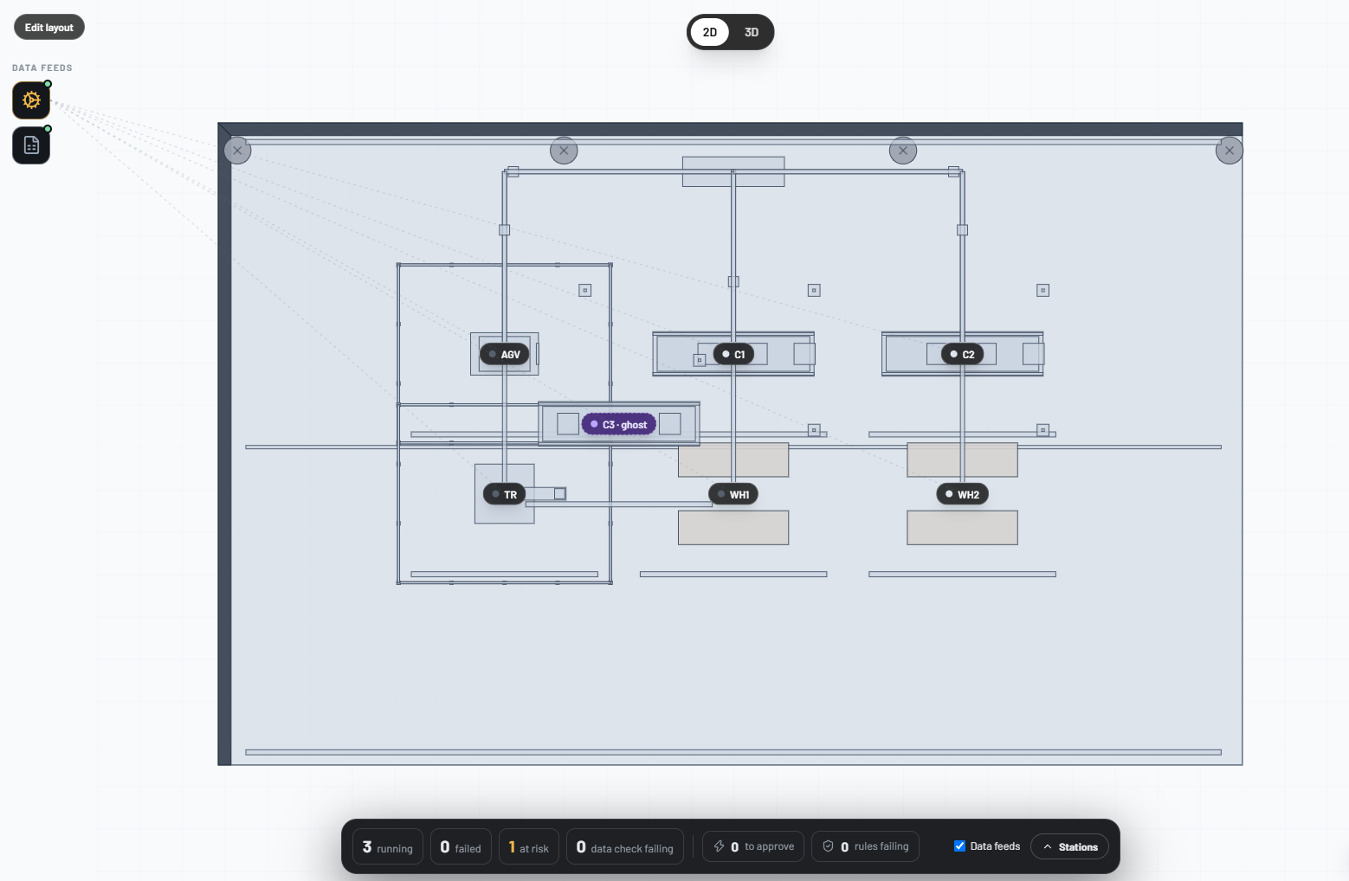
Brief about the idea
An agentic platform for manufacturing. It learns a plant from the plant's own documents and data, finds why a station failed, and acts only inside limits the owner sets.
Nine agents, one gateway. Four read the documents, connect the systems and build the model. Five run it: Diagnosis, Verifier, Planner, Warden and Sentinel.
Evidence before action. Every fact keeps the exact quote it came from. Instructions hidden in a file are removed, never obeyed. The Verifier recomputes every number a diagnosis cites.
Autonomy is a dial. Warden scores each action 0 to 100. The owner sets two lines: refuse, ask a person, or run alone. A hard limit from the documents is never crossed.
Built on Google Cloud. Gemini on Vertex AI in every agent, Cloud Run, Firebase sign-in.
The live floor: plan, data feeds and status.
9
465
10
agents
incidents backtested
live system types

Slide 3
Opportunities
How is it different from other ideas?
How will it solve the problem?
USP of the solution
It learns from the plant's own documents and data, not from a fixed template.
It finds the systems your documents name (MES, ERP, MongoDB, MQTT, MCP servers) and asks for each one by name.
Autonomy is a setting the owner controls, enforced by policy, not by a prompt.
It compiles scattered manuals, logs and orders into one checked model. Every fact has its quote.
When a station fails, Diagnosis, Verifier, Planner and Warden answer in about 20 seconds.
Sentinel watches data, services and certificates. Playbooks and channels reach the right person.
Evidence before action: a wrong number is sent back, a broken hard limit blocks the action.
Two lines you set, tried first on 465 recorded incidents before you trust them.
Every step is recorded. Gemini works in every agent. Plain rules decide every safety result.
Plants already have the data and the experts. Tolerance connects them, checks its own answers, and leaves the authority with the people.

Slide 4
List of features offered by the solution
Guide onboarding
Document Reader
Live connectors
Your own MCP servers
Asks the plant name, reads the documents, settles conflicts, draws the plant.
Facts with exact quotes. Hidden instructions are removed first.
PostgreSQL, MySQL, SQL Server, Oracle, MongoDB, MQTT, Kafka, OPC UA, REST. Test, then connect.
They join the same hub. Only read-only tools can run.
Floor in 2D and 3D
Layout editor
Operations
Warden gate
A Pascal plan and 3D view, with every data feed joined to its stations.
Move, add and delete stations. Draw how parts flow.
Diagnosis, Verifier, Planner and Warden in one run, step by step.
Score 0 to 100, your two lines, hard limits, a backtest.
Sentinel
Playbooks
Approval channels
Private by design
Plain rules on data, services and certificates. Maintenance windows.
Draw what should happen when a station fails.
Slack, Teams, Discord, Telegram or a webhook.
Firebase sign-in, a private plant per user, encrypted passwords, usage caps.

Slide 5
Process flow diagram or Use-case diagram
Set up once
Give the plant name and documents
Connect the systems the documents name
The model is compiled, each fact with its quote
The owner confirms what was understood
The floor goes live in 2D and 3D
The owner sets the two lines
When a station fails
Diagnosis
finds the cause with read-only tools
Verifier
recomputes every number it cites
Planner
proposes the fix with exact settings
Warden
hard limits, then a score from 0 to 100
Blocked or refused: does not run
A person approves: in the app or chat
Runs by itself: inside your limit
Then: the Action Broker applies only what the gate allows, in a simulator. Every model call, tool call and decision is recorded. Who uses it: the plant owner sets it up and the limits, an operator reads the floor, a person approves the middle zone.

Slide 6
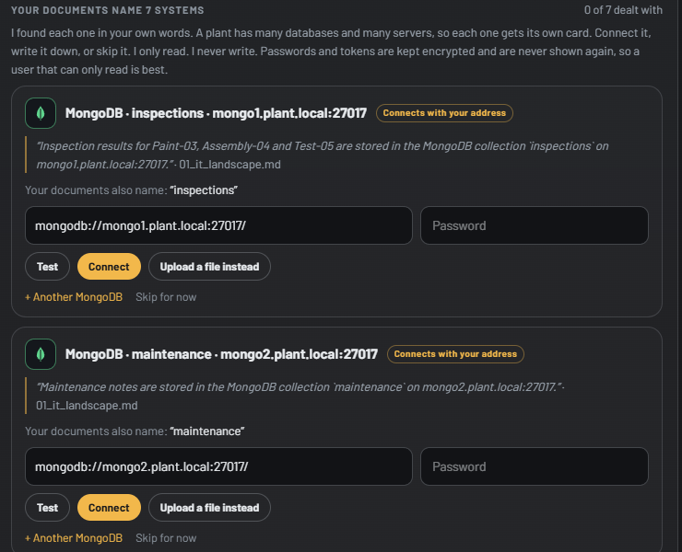
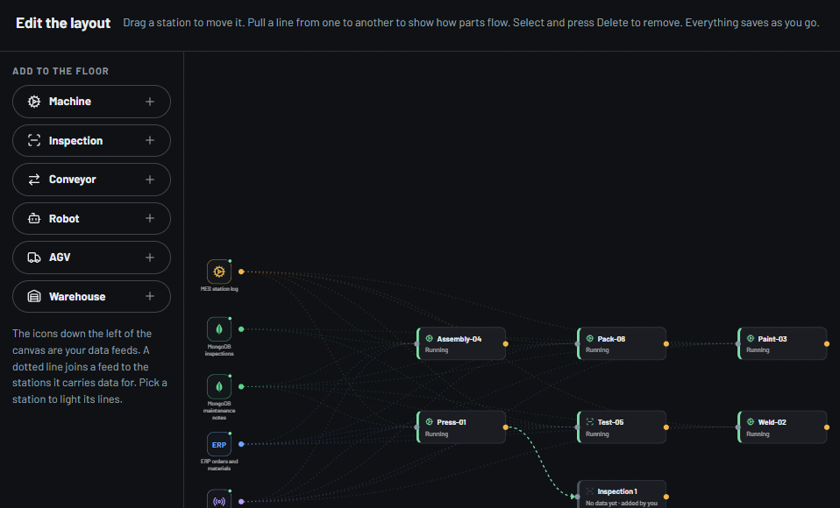
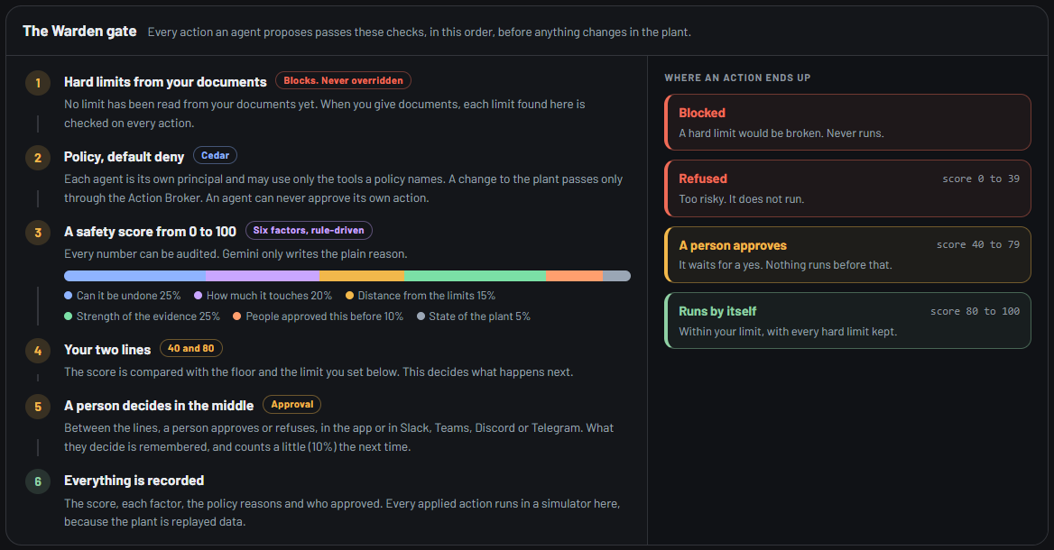
Wireframes/Mock diagrams of the proposed solution (optional)
The Guide asks for each system the documents name, with the sentence that names it.
The layout editor: move and add stations, draw part flows.
The Warden gate: every rule an action must meet.
These are screens of the running prototype, not sketches.

Slide 7
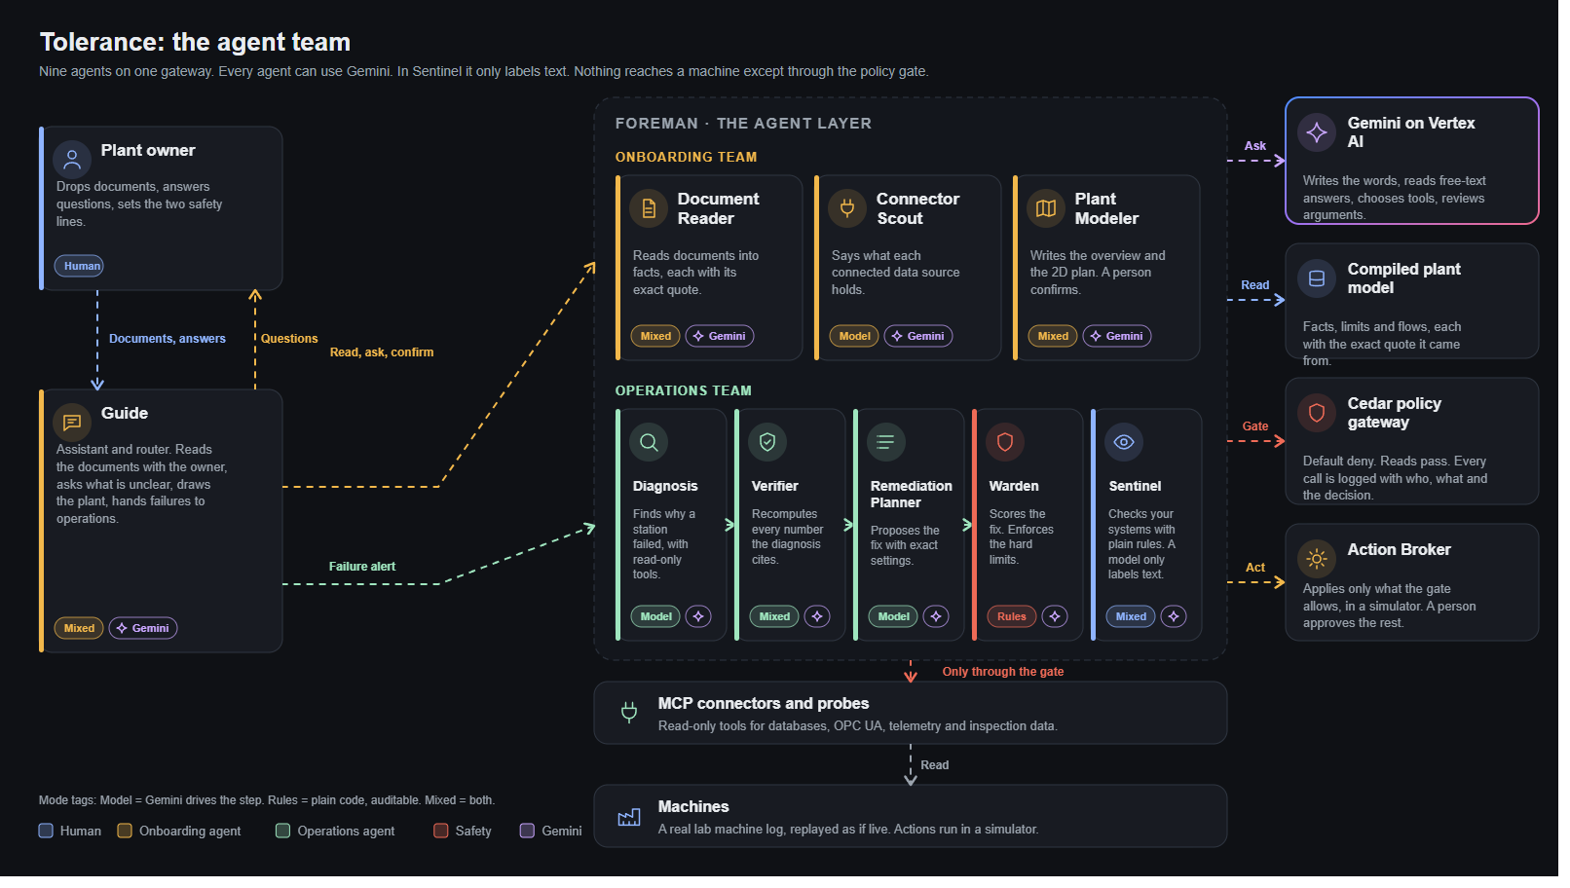
Architecture diagram of the proposed solution
How it fits together
One container on Cloud Run: the web app and the API.
Foreman: runs the nine agents, with a contract card and a record of every step.
Gemini on Vertex AI writes the words, reads answers and picks tools.
Cedar policy gateway: default deny; nothing reaches a machine except through it.
MCP hub: built-in and the owner's own servers; only read-only tools run.
Data lake: DuckDB, loaded once and kept current by connectors.
The agent team: owner, Guide, onboarding and operations agents, shared services, policy gateway and machines.

Slide 8
Technologies to be used in the solution
Google Cloud
Agents and safety
Data and connectors
Web
Gemini on Vertex AI (Gemini 2.5 Flash and the flash-lite family)
Cloud Run, one always-on instance
Firebase Authentication (Google, email, guest)
Cloud Build and Artifact Registry
Foreman agent layer, Gemini function calling
Cedar policy, default deny
Model Context Protocol (hub and client)
Rule-driven Warden and Sentinel
DuckDB lake, dlt loaders
SQLAlchemy: PostgreSQL, MySQL, SQL Server, Oracle
pymongo, MQTT, Kafka, OPC UA (asyncua)
Encrypted vault for passwords
Next.js 16 and React 19
Pascal Editor viewer (2D plan, 3D)
three.js, React Flow
FastAPI backend
Gemini is called through one gateway: a daily cap, model rotation when a model is busy, recorded answers as a fallback, and a visible notice when Gemini is under load.
Open source is used under its own licence; the licences are listed in the repository.

Slide 9
Estimated implementation cost (optional)
Cloud Run
One always-on instance (2 vCPU, 2 GiB) serves the web app and the API.
Kept small on purpose
The build is planned to stay under $100 of the $300 credit.
Caps that keep it there
A daily limit on Gemini calls
A quota per visitor, tighter for guests
Recorded answers replay for free
To grow: one lake per plant in Cloud SQL or Cloud Storage, more instances under load, and a model budget per customer.
Gemini on Vertex AI
A daily cap of 1,500 calls and a quota per visitor. Recorded answers replay without a call.
Firebase Authentication
Free tier covers sign-in with Google, email and guest.
Cloud Build, Artifact Registry
A build per deploy.
Data
Files and DuckDB inside the container. No managed database yet.

Slide 10
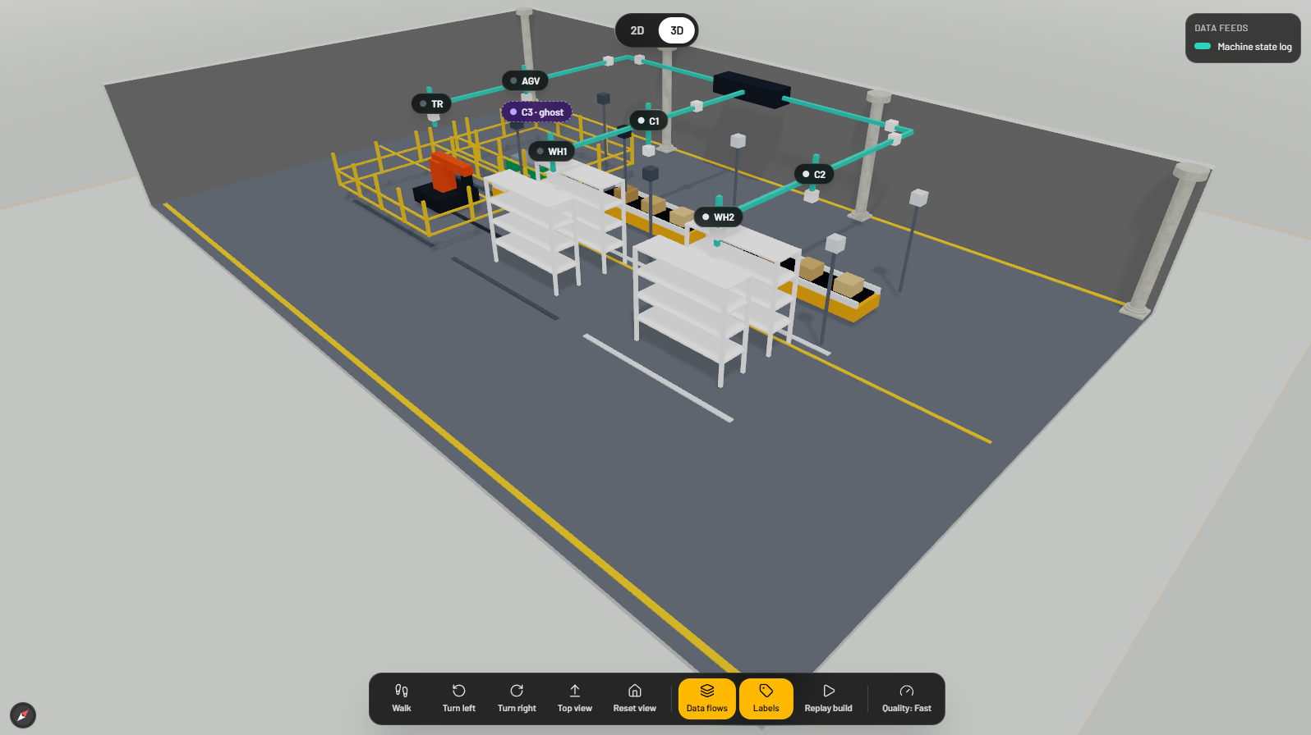
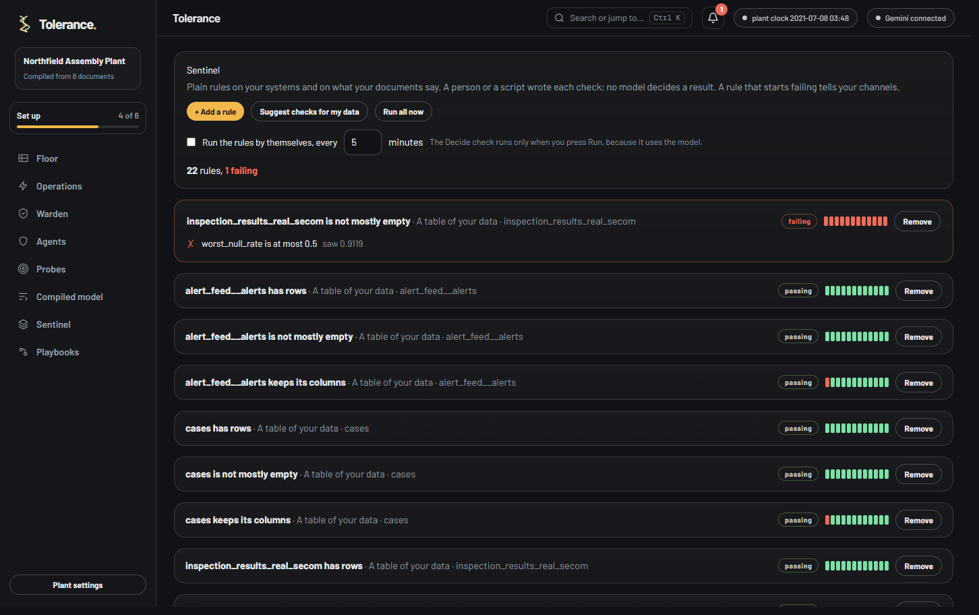
Snapshots of the prototype
The demo plant in 2D: data feeds, name tags and the status panel
The same plant in 3D, with its data flows
The layout editor
The Warden gate
Sentinel rules

Slide 11
Prototype Performance report/Benchmarking
465
75%
~18 s
0.2 s
real fault-injection incidents replayed through Warden
of those diagnoses were right
failed station to a scored plan, measured locally
a read-only MCP tool call, measured locally
Warden with the default lines (40 and 80)
149 would run alone: 120 right, 29 wrong
316 would wait for a person
The incident set is software faults (RCAEval). There is no history from a real plant yet.
Checks that pass today
12 automated suites: policy, agents, Sentinel, probes, connectors, vault, MCP.
Real PostgreSQL and MQTT connected, loading only what is new.
A remote MCP server: a read-only tool runs, an acting tool is denied.
Not yet tested live: Kafka, Oracle, SQL Server, MySQL.
Figures come from the running prototype on one computer. Gemini's speed varies with load, so the app shows a notice when Gemini is busy and the plain rules answer instead.

Slide 12
Benchmarking: finding the root cause on RCAEval
What this is
Real fault-injection cases on three microservice systems. We use RCAEval's own scorer and the authors' own BARO code, unmodified.
Our harness reproduces the paper on Online Boutique and Sock Shop. Train Ticket does not (0.652 against the paper's 0.79).
Gemini is not used for these numbers.
Where we do not win
On RE3 (code-level faults) the result is mixed: with weights tuned out of sample we win 1 of 3 systems.
With out-of-sample fusion, Train Ticket on RE1 falls to 0.744, below the published 0.79.
A benchmark of software incidents, not of a factory: it tests the ranking behind Diagnosis. Everything is reproducible from the repository.

Slide 13
Additional Details/Future Development (if any)
Tune Gemma for Sentinel
Gemini sorts short texts into labels today. We plan to fine-tune Gemma for that one classification job, with plain rules still judging the result.
Reach private plant networks
Probes or a tunnel so a cloud copy can read systems inside a factory network.
A pilot with a real plant
Replace the replayed lab log and software incidents with a customer's own history.
Write actions behind Warden
Let remote MCP tools act, only through the gate and with a person's approval.
More live checks
Test Kafka, Oracle, SQL Server and MySQL against live servers. Add roles for approvers and many plants per owner.

Slide 14
Provide links to your:
GitHub Public Repository: https://github.com/shreyash-sharma/tolerance
Demo Video Link (3 Minutes): to be added
Final Product Link: https://tolerance-749288317336.asia-southeast1.run.app
How to try it
1
2
3
Open the final product link.
Choose Register, Sign in, or Try it as a guest. A guest gets a private plant with usage caps.
Give a plant name and drop documents, or load the made-up plant that has MES, MongoDB, ERP and IoT data.

Slide 15
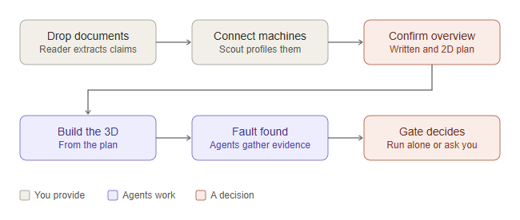
Appendix: the journey, from documents to a decision
Six steps
You provide the documents and name the systems that hold the data.
The agents read, connect and compile. You confirm what was understood.
The plant is built from the checked facts, in 2D and 3D.
When a fault is found, the agents gather evidence. The gate decides: it runs alone, or it asks you.
Boxes in grey are what you provide, in blue what the agents do, in red a decision.

Slide 16
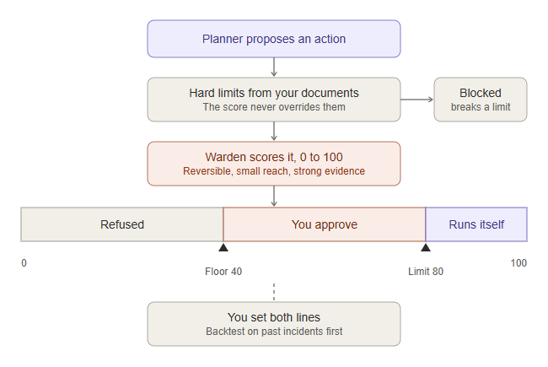
Appendix: the safety gate, limits first and then the score
Why this order
A hard limit from your documents comes first. A score never overrides it.
Warden then scores the action from 0 to 100 on six factors: can it be undone, how much it touches, distance from the limits, strength of the evidence, what people approved before, and the state of the plant.
You set the floor and the limit. Below the floor it is refused. In the middle you approve. At or above the limit it runs by itself.
You see what your lines would have done on 465 recorded incidents before you trust them.

Slide 17
Appendix: the onboarding team, four agents that learn your plant
Guide
Model and rules · Gemini
Document Reader
Model and rules · Gemini
Use case: A plant's documents disagree and have gaps. Only the owner can settle them.
Solution: Runs the Document Reader, Connector Scout and Plant Modeler, then asks the owner one question at a time. Gemini writes the words and reads free-text answers. Code checks each answer before it changes anything.
Outcomes: Settled conflicts · Confirmed limits · What the plant makes · A confirmed overview · A drawn layout · A tour of the app
Must never: Apply an answer that does not match an open question; Write to the plant; Obey instructions found inside documents
Use case: Manuals, work instructions and safety sheets hold the limits and the structure of the plant.
Solution: Gemini extracts claims; code checks every quote against the page; instructions hidden in documents are removed first.
Outcomes: Claims with quotes · Conflicts between documents · Missing facts · Hidden instructions flagged
Must never: Obey instructions found inside documents; Write to the plant
Connector Scout
Model-driven · Gemini
Plant Modeler
Model and rules · Gemini
Use case: A plant has ERP, MES, PLC and file data. Someone must say which is which.
Solution: MCP servers list sources and tables. Gemini names the role of each table from its columns.
Outcomes: Role of each table · Which sources are live · What data is missing
Must never: Write to the plant; Read rows outside SELECT
Use case: The 3D model must come from facts a person has checked.
Solution: Stations from data, material flow from the documents, limits from the documents. Gemini writes the overview and each sentence cites its source.
Outcomes: Written overview · 2D plan · Limits list · Confirmation gate
Must never: Build the 3D before a person confirms

Slide 18
Appendix: the operations team, four agents that keep it running
Diagnosis
Model-driven · Gemini
Verifier
Model and rules · Gemini
Use case: A station stopped. Someone must say why, fast.
Solution: Gemini picks MCP tools, reads the results and submits a cause with evidence. Cedar allows each call.
Outcomes: Cause · Evidence per claim · Tool trace
Must never: Write to the plant; Call a tool Cedar denies
Use case: A model can sound sure and be wrong.
Solution: Rule checks recompute every cited number from the tool results. Gemini then reviews the argument. A hard check cannot be talked away.
Outcomes: Supported or not · Issues list · Evidence score
Must never: Approve a claim whose numbers do not match
Remediation Planner
Model-driven · Gemini
Warden
Rule-driven · Gemini
Use case: After a cause is known, someone must choose a fix that respects the plant's limits.
Solution: Gemini proposes actions from the diagnosis and the limits. Warden scores each. Nothing is applied here.
Outcomes: Action list · Exact settings · Why this action
Must never: Write to the plant; Propose a setting above a hard limit as the first choice
Use case: Some fixes are small and some can stop a line. The user decides how far the system may go alone.
Solution: Six factors give a score from 0 to 100. The user sets a floor and a limit. Cedar enforces them at the Action Broker.
Outcomes: Score with factors · Auto, approve or refuse · Backtest on past incidents
Must never: Let a high score override a hard limit

Slide 19
Appendix: plain rules, your playbooks, your channels
Sentinel
Model and rules · Gemini
Playbooks
Rule-driven
Use case: A plant's IT side fails quietly: a feed stops, a column changes, a service is slow. A model should not be the judge of that.
Solution: Plain rules check a field against a value on your data tables, a web address, a port, a service or a certificate. A schedule runs them, maintenance windows keep planned work quiet, and an impact map shows which stations lose data. A rule that fails or recovers tells your channels.
Outcomes: Pass or fail for each rule · The stations that lose data · A message when a rule fails or recovers
Must never: Write to the plant; Let a model say pass or fail; Reach a private network address
Use case: Each plant reacts to a failure in its own way.
Solution: The owner draws a trigger, checks, a decision and actions on a canvas. Code walks it. Warden scores any action that changes the plant.
Outcomes: A trace of every block · Actions scored by Warden
Must never: Skip Warden for an action that changes the plant
Channels
Rule-driven
Layout editor
Rule-driven
Use case: A person who is not in the app must still know when to approve.
Solution: Warden messages Slack, Teams, Discord, Telegram or a webhook. Addresses stay on the server. Private addresses are refused.
Outcomes: Approval requests · Blocked actions · Failing rules
Must never: Send to a private network address; Show an address back in the app
Use case: The drawn floor is never exactly right.
Solution: A node canvas next to the live floor: move, add and delete stations, rename them, and draw how parts flow. Every change is saved at once and the plan and 3D view follow.
Outcomes: Moved, added or deleted stations · Part flows between stations
Must never: Change data or limits

Slide 20


